Slide 1
Airbnb Price Predictions using Machine Learning
Teammates:
1.Shiva Sai Chakilam – 700742073
2.Harshith Reddy Vallem – 700741921
3.Hareesh Muppu – 700732514
4.Vinay Manavarthi - 700731595

Slide 2
CONTRIBUTIONS TEAMMATE : SHIVA SAI CHAKILAM Selecting the dataset required and removing complex datasets for analysing and organizing it as necessary. TEAMMATE HARSHITH REDDY VALLEM Arranging the data as required and getting the graphical representation of the data i.e data visualisation and analysing and used two types of algorithms i.e. multiple regression as we need a dependent variable by usage of independent variables and got the predictions. TEAMMATE HAREESH MUPPU Using the machine learning technique(algorithm) to get the predictions i.e model defining. TEAMMATE VINAY Evaluating the data set of training and documenting the predictions and evaluated the prediction from the all types of algorithms and documentation with the data

Slide 3
Executive Summary
Airbnb is a $75 billion dollar internet marketplace for renting out vacation homes, villas, and private rooms. Each booking generated by the website is subject to a commission (3 to 20%).
While the prospects appear to be favourable, some opponents believe that this has resulted in an increase in rent and a negative impact on the surrounding neighbourhoods.
Pricing a rental property on Airbnb is a difficult issue for the owner since it dictates the amount of consumers that will stay at the home.
We begin this project by cleaning and preprocessing the data.
We next do descriptive, prescriptive, and exploratory analysis in order to gain a deeper grasp of the data's nature.
To forecast prices, neural network-based linear regression models were constructed. Following implementation of the aforementioned technique, the best model was picked based on the model's root mean square error (RMSE).

Slide 4
Motivation
The objective of this project is to do Descriptive analysis, Prescriptive analysis and Predictive analysis. With that analysis we will be able to answer the following questions.
Descriptive analytics
How many listings are available in the neighbourhood?
When are the prices high and low?
Which neighborhoods are considered safe for hosting?
Long-term rentals instead of leasing?
Presence of professional hosting service providers?

Slide 5
Motivation
Prescriptive
Based on the customer budget, they can either opt for an entire house or just a room or even better share a room.
With a range of prices as low as 700 to as high as 50,000, comes a range of amenities, such as selection on a number of beds, bedrooms, kitchen, air conditioning, heating washing machine, breakfast, beachfront, gym, pool etc to name a few.
Predictive Analytics
Which locations give the higher revenue ?
To predict the price based on the user selected attributes.

Slide 6
Dataset Source & Description
Source : Kaggle
Link: https://www.kaggle.com/c/bu-cs542-fall19/overview/description
The dataset consists of (e.g., host's response time, average review score, etc.) and the listing price (per day) which is the target output.
The dataset has already been split up into train, val and test sets.
We will use the train/dev sets with provided labels for our model development and predictions on the test set.

Slide 7
Data Transformation
To begin, the authors inspected each feature in the dataset to
(i) remove features with frequent and irreparable missing fields or to set missing values to zero where appropriate
(ii) convert some features to floats (e.g., by removing the dollar sign from prices)
(iii) convert boolean features to binaries
(iv) remove irrelevant or uninformative features, e.g. host image url, constant valued fields, or duplicate features.
(v) Additionally, the characteristics and labels were standardised and transformed to the logarithm of the prices to limit the influence of the dataset's outliers.

Slide 8
Data Transformation
The data was divided into three sets: the train set (which contained 90% of the original data), the validation set, and the test set (both comprising 5 percent of original data).
Due to the dataset's size, 10% of the data was judged adequate for the cumulative testing and validation sets.
We have learned thus far in the study that the price of a listing appears to be impacted by a variety of elements.
Following the selection of a collection of characteristics, we attempt to create a prediction model using regression analysis.
This statistical approach is used to establish the link between one or more dependent variables and one or more independent variables.

Slide 9
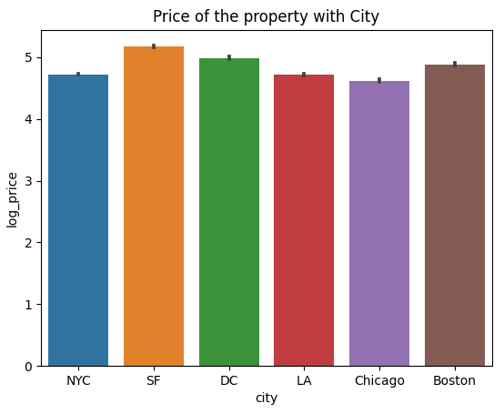
Exploratory Data Analysis
The fig shows how the log price of the houses are varying based on the cities.
San Francisco has the higher price houses whereas New york city has the minimum price houses when compared to other US cities.

Slide 10
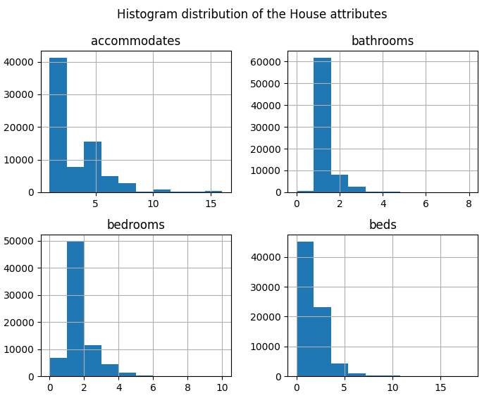
Exploratory Data Analysis
Fig illustrates the histogram distribution of four important features in predicting price.
Bedrooms, bathrooms, beds count and number of accommodates. Histogram shows that most of the houses have a single bedroom with a single bathroom and bed. Number of accommodations are ranging from 1 to 8.

Slide 11
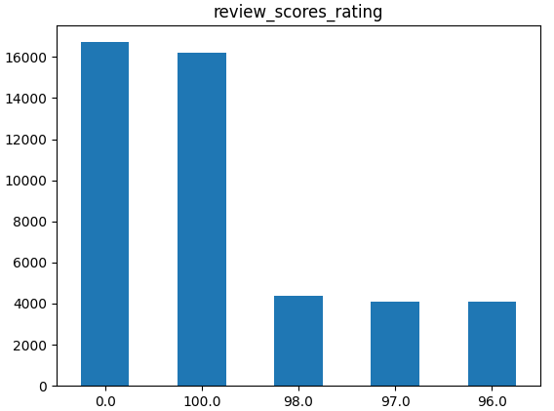
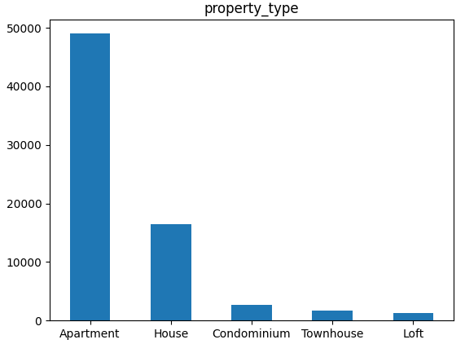
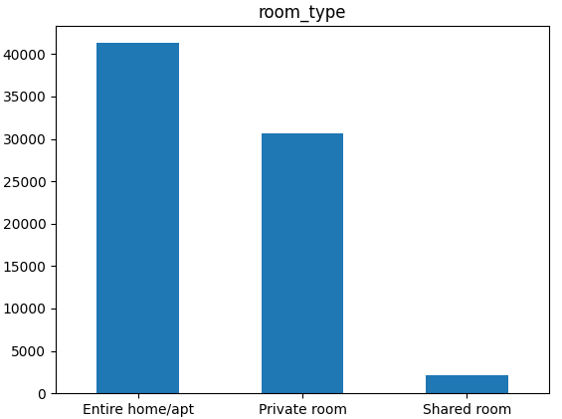
Exploratory Data Analysis
Fig 3c
Fig 3b
Fig 3a

Slide 12
Exploratory Data Analysis
Figures shows the number of properties in different categories using a bar chart.
Fig 3a shows the property type in which apartment type property is 50% of total datasets. The second highest is individual house types.
Fig 3b illustrates Airbnb is hosting an entire apartment or house in their listing. People are also preferring private rooms as their second option.
Fig 3c shows a clear boundary between the review scores, the properties are splitted into two categories, 95 and above is one category and 0 is the other categories.
The properties are divided in 50-50 ratio which means half of the properties are not good or upto the mark.

Slide 13
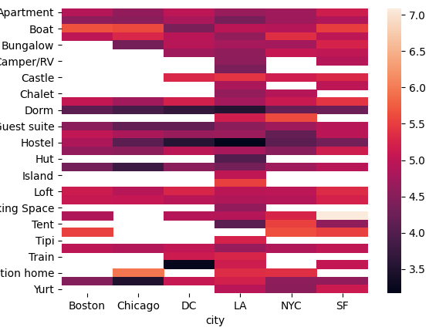
Exploratory Data Analysis
Fig shows the correlation between types of houses and city.
Chicago has the minimum number of types which means it has houses of types more of Apartment and hostels whereas Los Angeles has almost each and every type of houses.
It does cover all types of the houses in the airbnb category.

Slide 14
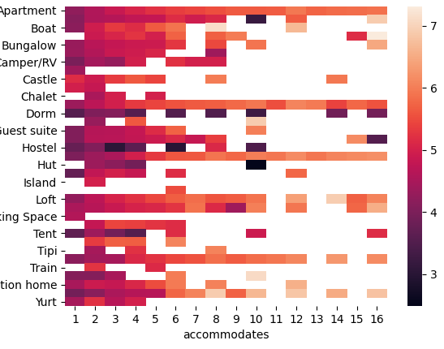
Exploratory Data Analysis
Fig shows the correlation between number of accommodations and different types of property.
The graph clearly shows that most of the houses or properties are allowing 1 to 6 members to accommodate.
Very few property types have a space to accommodate more people like Yurt, Bungalow.

Slide 15
Models- Random Forest Regressor
Random Forest overcomes this issue by training multiple decision trees at the expense of mildly enhanced bias on a distinct subspace of the feature space.
This means that the entire training data is not seen by any of the trees in the forest. The information is divided into partitions recursively.
The split is performed at a specific node by asking a query about an attribute.
The choice for the criterion of splitting is based on certain measures of impurity such as Shannon Entropy or impurity of Gini.

Slide 16
Models - K-nearest neighbor Regression
K-nearest neighbor is an algorithm of machine learning regarded as easy to execute.
The issue of stock prediction can be mapped into a classification based on resemblance.
A set of vectors maps the historical stock information and the test information.
For each stock feature, each vector reflects the N dimension.
The stock market closing price forecast is calculated using kNN as follows:
Determine the number of neighbors closest to you, k.
Calculate the distance to the query record between the training samples.
Classify all training documents by range.
Use the majority vote for the class labels of the closest neighbors and assign it as the predictive value of the query record.

Slide 17
Models - Ridge Regressor
Ridge regression is a model-tuning method that is used to analyze any data that suffer from multicollinearity.
This method performs L2 regularization.
When the issue of multicollinearity occurs, least-squares are unbiased, and variances are large, this results in predicted values being far away from the actual values.
In ridge regression, the first step is to standardize the variables (both dependent and independent) by subtracting their means and dividing by their standard deviations.
This causes a challenge in notation since we must somehow indicate whether the variables in a particular formula are standardized or not.

Slide 18
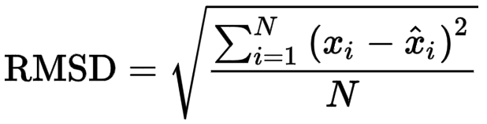
Evaluation
After making predictions with the given weights and biases, the final RMSE score is 0.22, which is rather low.
RMSE is an abbreviation for root mean squared error.
The discrepancy between the actual and anticipated values is called the root mean squared error.
The RMSE error formula is as follows:,

Slide 19
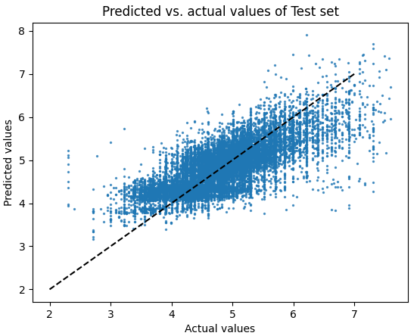
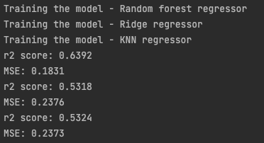
Evaluation

Slide 20
Findings and Managerial Implications
Descriptive analysis has been carried out for finding out the means, modes and standard deviations of all the variables.
The mode for increasing the satisfaction and productivity as the apartment type houses are making more profit with more than 1 bedrooms.
Pearson Correlation analysis has been carried out to find out whether there is any significant relationship between any two variables.
The Correlation data shows that the number of bedrooms and bathrooms along with the house types highly correlated with the price.

Slide 21
Conclusions
Our study is primarily focused on conducting proper research using Airbnb data from various places around the United States.
The purpose of this article is to develop the best model possible for forecasting Airbnb rates using a restricted set of data, including property characteristics, owner information, and customer reviews on listing pages.
The initial testing with the baseline model established that the model's plethora of features results in a significant variance and poor performance on the validation set relative to the train set.
This degree of accuracy is a promising result given the dataset's heterogeneity and the hidden elements and interacting words involved, including the owners' personal qualities, which were difficult to examine.

Slide 22
Reference
[1] Mao, Zhenxing, and Jiaylng Lyu, “Why travelers use Airbnb again?” International Journal of Contemporary Hospitality Management (2017).
[2] Li, Yang, et al. “Price Recommendation on Vacation Rental Websites.”Proceedings of the 2017 SIAM International Conference on Data Mining. Society for Industrial and Applied Mathematics, 2017.
[3] Moon, Hyoungeun, et a1. “Peer-to-peer interactions: Perspectives of Airbnb guests and hosts.” International Journal of Hospitality Management 77 (2019): 405-414.
[4] Sheppard, Stephen, and Andrew Udell. “Do Airbnb properties affect house prices?” Williams College Department of Economics Working Papers 3.1 (2016): 43.
[5] Dogru, Tarik, Makarand Mody, and Courtney Suess. “Adding evidence to the debate: Quantifying Airbnb’s disruptive impact on ten key hotel markets.” Tourism Management 72 (2019): 27-38.
[6] Wang, Dan, and Juan L. Nicolau. “Price determinants of sharing economy-based accommodation rental: A study of listings from 33 cities on Airbnb.com.” International Journal of Hospitality Management 62 (2017): 120-131.
[7] Oskam, Jeroen, and Albert Boswijk. “ Airbnb: the future of networked hospitality businesses.” Journal of Tourism Futures (2016).
[8] Quattrone, Giovanni, et a1. “ Who benefits from the “Sharing” economy of Airbnb?” Proceedings of the 25th international conference on the world wide web. 2016.
[9] Zervas, Georgios, Davide Proserpio, and John Byers. “A first look at online reputation on Airbnb, where every stay is above average.” Where Every Stay is Above Average (January 28, 2015) (2015).
[10] Varma, Arup, et al.“Airbnb: Exciting innovation or passing fad?” Tourism Management Perspectives 20 (2016): 228-237

Slide 23
Reference
[11] Guttentag, Daniel A., and Stephen LJ Smith. “Assessing Airbnb as a disruptive innovation relative to hotels: Substitution and comparative performance expectations.” International Journal of Hospitality Management 64 (2017): 1-10.
[12] Dogru, Tarik, et a1. “Does Airbnb have a homogenous impact? Examining Airbnb’s effect on hotels with different organizational structures.” International Journal of Hospitality Management 86 (2020): 102451
[13] Goree, Katherine. “Battle of the beds: the economic impact of Airbnb on the hotel industry in Chicago and San Francisco”
[14] Moon, Hyoungeun, Wei Wei, and Li Miao. “Complaints and resolutions in a peer-to-peer business model.” International Journal of Hospitality Management 81 (2019): 239-248.
[15] Bashir, Makhmoor, and Rajesh Verma. “ Airbnb disruptive business model innovation: Assessing the impact on the hotel industry.” International Journal of Applied Business and Economic Research 14.4 (2016): 2595-2604.
[16] Chua, Evelyn L., Jason L. Chiu, and Nelson C. Bool. “Sharing Economy: An Analysis of Airbnb Business Model and the Factors that Influence Consumer Adoption.” Review of Integrative Business and Economics Research 8 (2019): 19.
[17] Neeser, David, Martin Peitz, and Jan Stuhler. “Does Airbnb hurt hotel ˆ business: Evidence from the Nordic countries.” Universidad Carlos III de Madrid (2015): 1-26.
[18] Gibbs, Chris, et a1. “Pricing in the sharing economy: a hedonic pricing model applied to Airbnb listings.” Journal of Travel Tourism Marketing 35.1 (2018): 46-56.
[19] Chua, Evelyn L., Jason L. Chiu, and Nelson C. Bool. “Sharing Economy: An Analysis of Airbnb Business Model and the Factors that Influence Consumer Adoption.” Review of Integrative Business and Economics Research 8 (2019): 19.
[20] Roma, Paolo, Umberto Panniello, and Giovanna Lo Nigro. “Sharing economy and incumbents’ pricing strategy: The impact of Airbnb on the hospitality industry.” International Journal of Production Economics 214 (2019): 17-29.
[21] Tayeb, S., Pirouz, M., Sun, J., Hall, K., Chang, A., Li, J., ... & Latifi, S. (2017, December). Toward predicting medical conditions using k nearest neighbors. In 2017 IEEE International Conference on Big Data (Big Data) (pp. 3897-3903). IEEE.

